Slide 1
Courting Civilians During Conflict: Evidence from Taliban Judges in Afghanistan (Grasse D, et al. 2024)
Replication assignment for Applied Stats II
Tolga Bag
3.4.2024

Slide 2
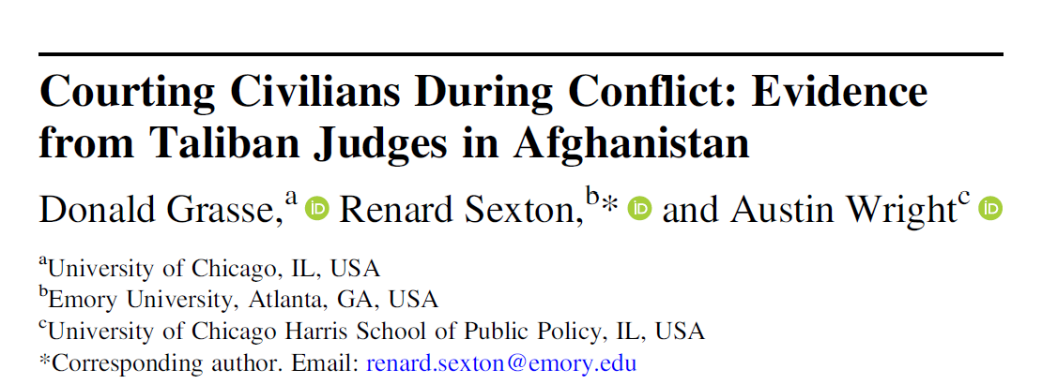
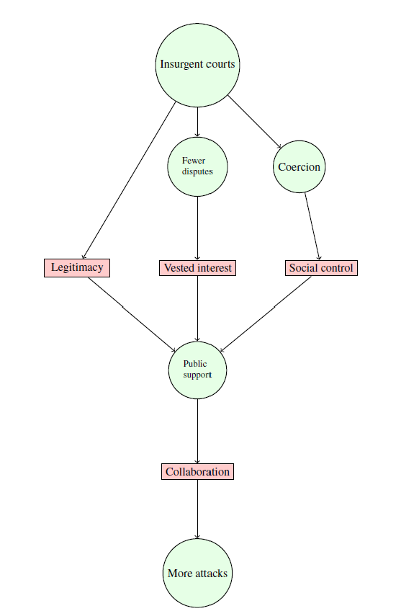
Summary I
Authors examine courts established by Taliban («rebel courts») when Afghanistan was ruled by an elected government that was supported by international coalition forces led by the US between 2001-2013.
Research Questions:
Do rebel courts affect civilian attitudes and battlefield performance?
Do rebel courts resolve major disputes?
Do rebel courts increase coercion of civilians?
Do attacks increase because of civilian collaboration?
Theoretical Hypotheses:
Courts are a key foundation of rebel governance
Rebel courts can sway civilians to support insurgents through several mechanisms:
legitimization of the rebellion;
facilitating coercive control of the population;
creating a vested interest in continued rebel presence.
Rebels can use courts to increase their hold of information, coordinate attacks with more precision, and engage in more varied and intense violence
Notes:
They focus on mechanisms by which courts, rather than territorial control, can sway civilian attitudes and the tactical choices of insurgents.
Taliban established courts in mid-2000s, and they were well-established by 2011. Weirdly, in Taliban’s case courts preceded the territorial control.
Western-backed government had a backlog of legal cases dating back to 1980s, and there was corruption, while Taliban rotated their judges to prevent localized corruption. And their system was simpler.

Slide 3
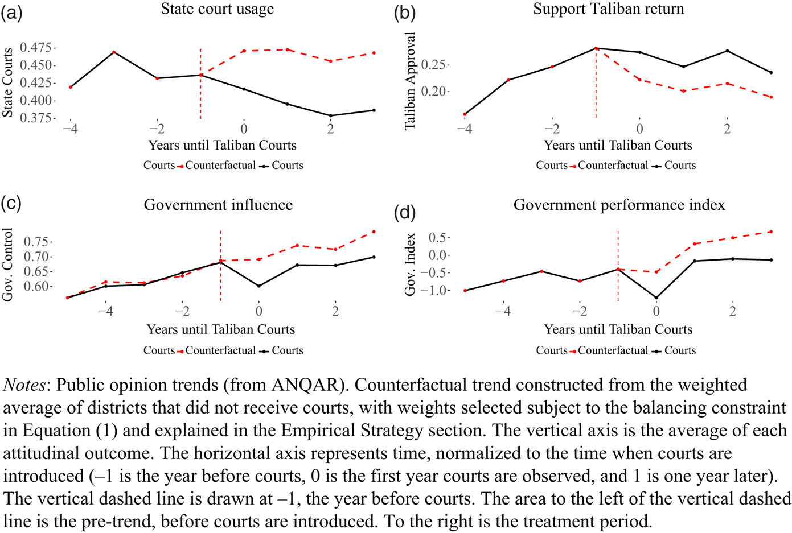
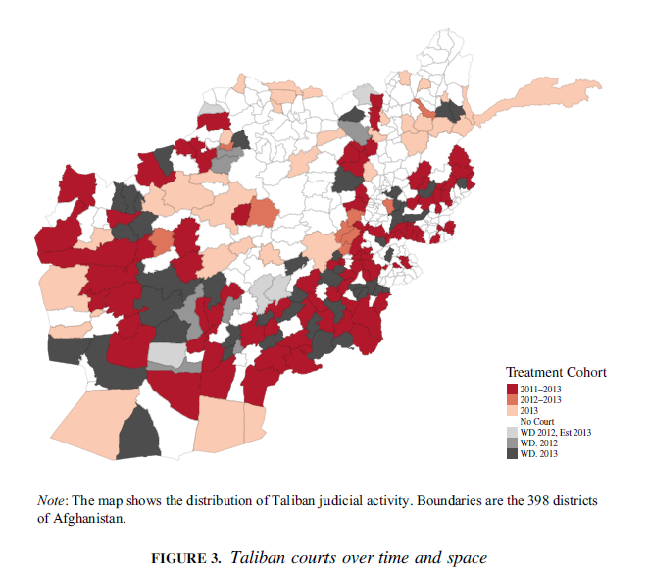
Summary II
Their findings highlight the complex interactions between warfare and institutional development in weak states.
They found out that rebel courts:
«reduced civilian support for the government and increased it for the Taliban»
«were associated with more attacks and more coalition casualties.»
«resolved major interpersonal disputes between civilians»
«facilitated more insurgent intimidation of civilians»
Also, «changes in public opinion [about the government & rebel courts] are unlikely to have been driven solely by social desirability bias.» as they are addressed through the estimation equation and an existing survey questions.
Notes:
WD means withdrawn and were largely unrelated to local conditions (i.e. public opinion, or conflict) but rather driven by disagreements of different branches of the Taliban.
Social desirability bias refers to the tendency of individuals to respond in a way that they believe is socially acceptable or desirable, rather than providing their true opinions or behaviours.

Slide 4
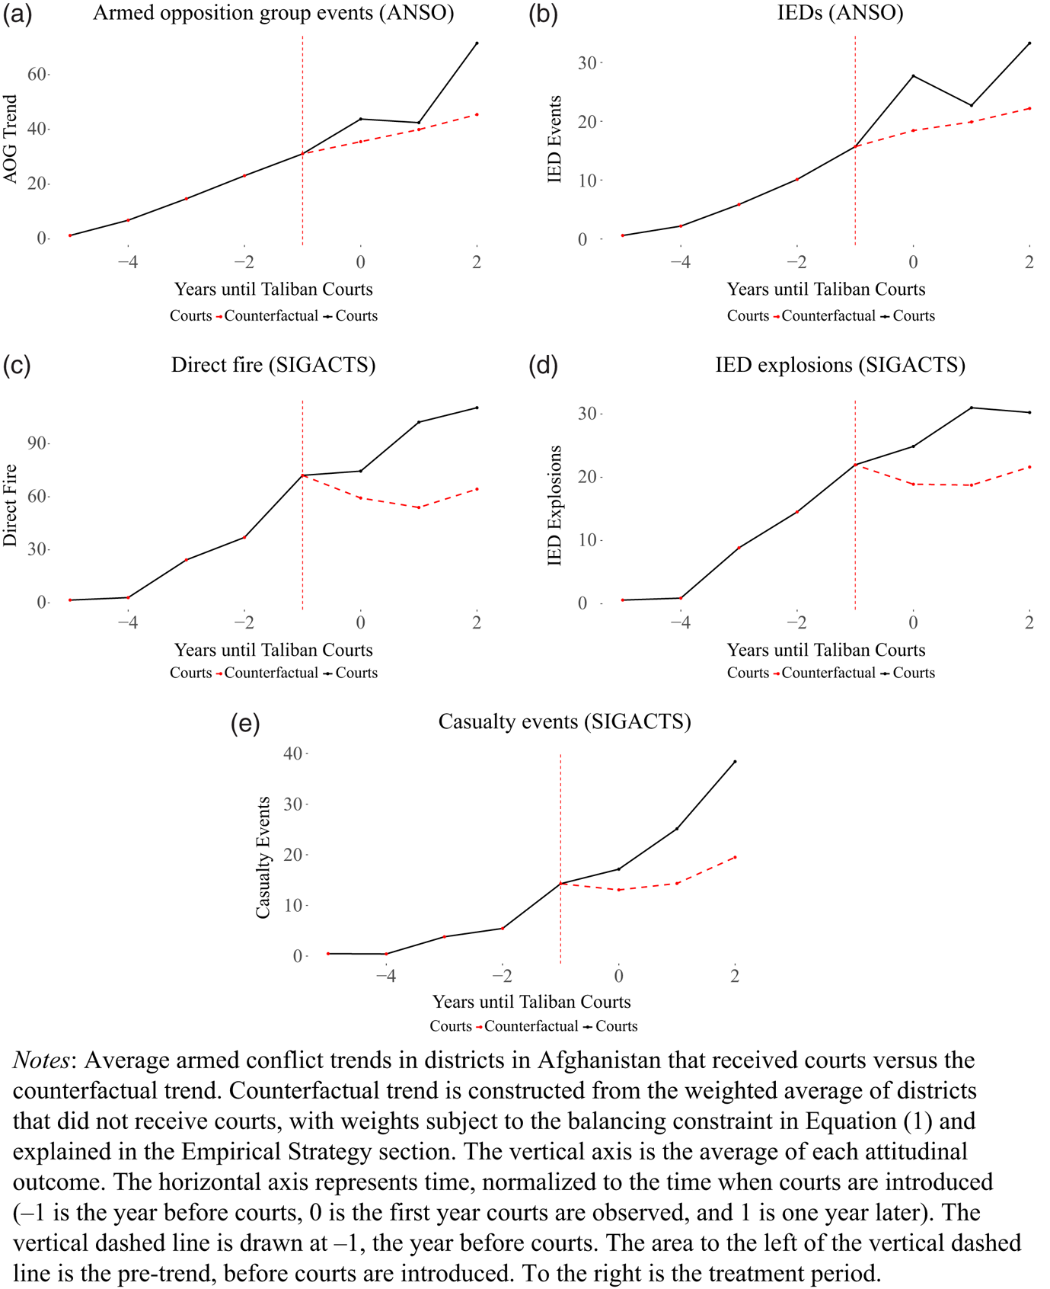
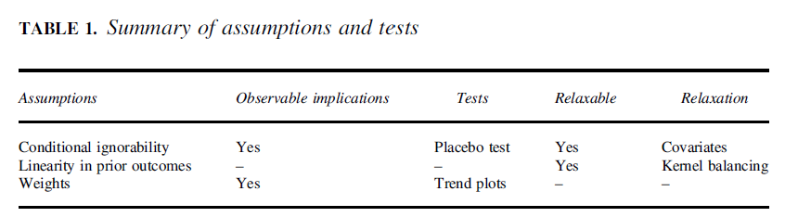
Data and Design
Data Collection:
presence of Taliban courts in Afghanistan from field reports & district boundary information;
survey data from the Afghanistan Nationwide Quarterly Assessment Research (ANQAR) survey
data of Afghan NGO Safety Office (ANSO) and International Security Assistance Force (ISAF) to measure combat events (SIGACTS). ​
They compared the districts that were exposed to courts to those that were never exposed, and they estimated the average treatment effect on the treated using weighted control groups. They had 4 groups:
the court group before courts
the court group after courts
the control group before courts
the control group after courts
They made 3 assumptions and addressed them.
Notes:
Empirically, they provide evidence that their mechanisms are distinct from pre-existing control by showing the robustness of their findings after conditioning on three measures of pre-treatment territorial control.
Assumption 1: Conditional ignorability: This assumption states that the potential outcome for treated units had they not been treated is independent of their treatment status, conditional on the trajectory of the outcome. They found the differences between treated and control districts were small and statistically insignificant, confirming the effect of courts.
A2: Linearity in prior outcomes: the potential outcome for the treated under control can be expressed as a linear function of past outcomes with a common intercept shift. They didn’t tested this directly, but they argued it is reasonable given the aggregation level of data for 30 years omitted seasonal patterns.
A3: Weight feasibility: The researchers provided support for this assumption by plotting the data for the treated and control groups and showing that a set of weights satisfying the constraints exists.

Slide 5
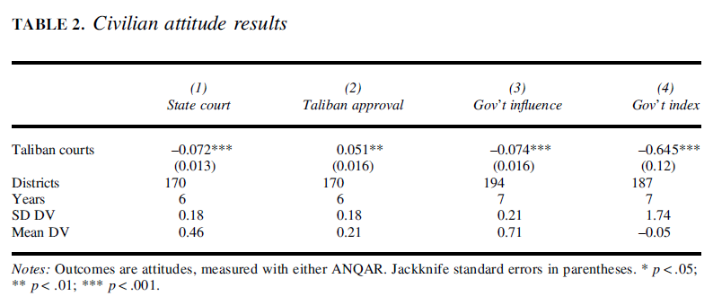
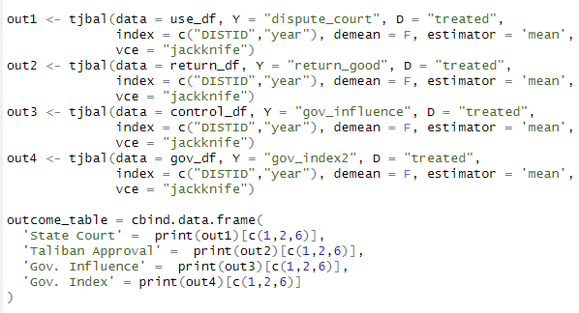
Replication I
I would like to replicate the Table 2: civilian attitude results
dispute_court: if people would use state courts
return_good: whether they say Taliban’s return is good
gov_influence: if gov has most influence in their village
gov index: people’s scoring of government performance
tjbal function calculates how these variables change over time based on district ID.
Column (1) here shows a 7 percent (nearly 0.4 σ) decline in the number of respondents reporting that they would take a dispute to a state court. Column 2 shows that after courts, 5 percent more respondents say that a return of the Taliban would be good for the country
Notes:
Jackknife standard errors give you a sense of how much your calculated statistic (mean in this instance) might vary if you had drawn slightly different samples from the population. Helpful when strandard errors are useful.
SD DV - Standard Deviation of Dependent Variable (civilian attitudes). It is a measure of how spread out the data is from the mean.
Mean DV - Mean of the Dependent Variable: the mean is the average of the data points.
The difference between the Taliban courts and the state courts is nearly 0.4 standard deviations from the mean.
After loading the relevant dataset, filtering the years & columns, adding the treated/untreated info, and mergng each year’s dfs, and building a dataframe based on mean calculations of the specific variables, I use the tjbal package as described in the ReadMe notes.

Slide 6
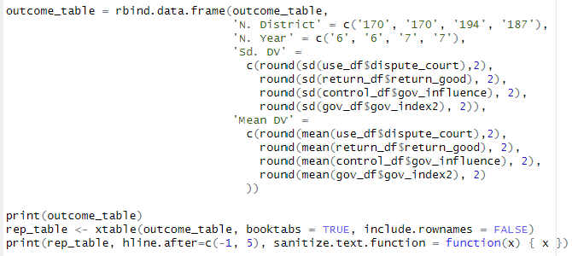
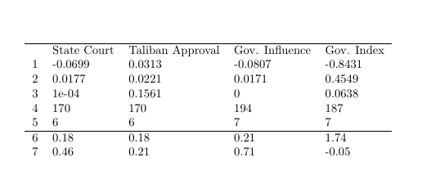
Replication II
dispute_court = State court
return_good = Taliban
gov_influence: Gov’t influence
gov index: Gov. Index
I replicated it, but found slightly results, with different p values (row 3 on my replication table).
Notes:
SD DV - Standard Deviation of Dependent Variable (civilian attitudes). It is a measure of how spread out the data is from the mean.
Mean DV - Mean of the Dependent Variable: the mean is the average of the data points.
The difference between the Taliban courts and the state courts is nearly 0.4 standard deviations from the mean.
After loading the relevant dataset, filtering the years & columns, adding the treated/untreated info, and mergng each year’s dfs, and building a dataframe based on mean calculations of the specific variables, I use the tjbal package as described in the ReadMe notes.

Slide 7
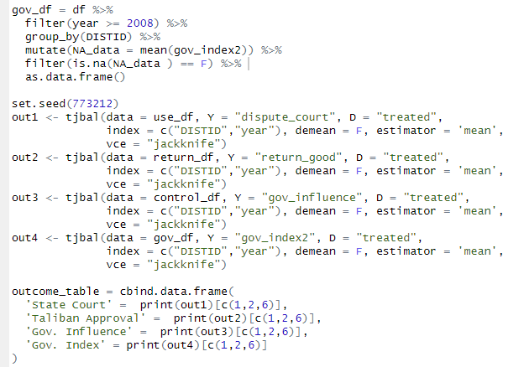
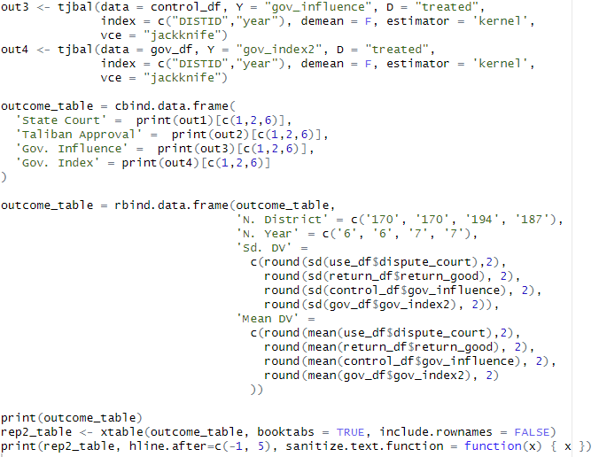
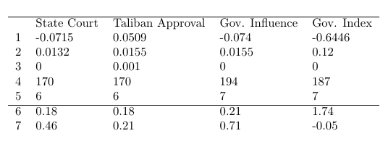
Replication III
After checking other R code files, I realized that the authors used set.seed(773212) for tjbal function’s calculations somewhere.
dispute_court = State court
return_good = Taliban
gov_influence: Gov’t influence
gov index: Gov. Index
After adding that, I replicate the result:
Notes:
SD DV - Standard Deviation of Dependent Variable (civilian attitudes). It is a measure of how spread out the data is from the mean.
Mean DV - Mean of the Dependent Variable: the mean is the average of the data points.
The difference between the Taliban courts and the state courts is nearly 0.4 standard deviations from the mean.
After loading the relevant dataset, filtering the years & columns, adding the treated/untreated info, and mergng each year’s dfs, and building a dataframe based on mean calculations of the specific variables, I use the tjbal package as described in the ReadMe notes.

